Slide 1

Healing the Heart
Addressing the Disparity Between Cardiovascular Prescription Utilization and Coverage
Team 1: Interdisciplinary Health Data Competition
Ben, Boyang, Lauren, Paul, William
Notes:
Don’t have a clear idea on the question we are trying to answer - need to clarify the question - data exploration to understand the disparity between coverage and large number of diseases
Addressing the Disparity Between Cardiovascular Prescription Utilization and Coverage
Cost-benefit analysis can still be done after making assumptions - if we increase coverage by 10% how much can we save
Clustering

Slide 2
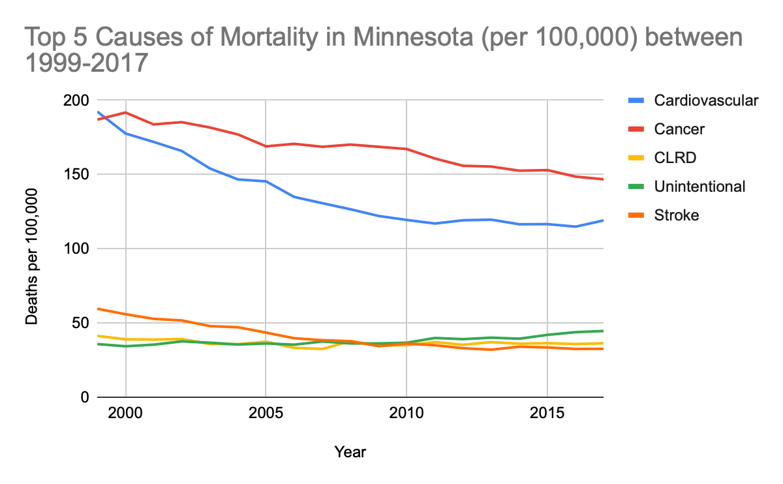


BURDEN OF CARDIOVASCULAR DISEASE IN MINNESOTA
BACKGROUND & MOTIVATION
METHODOLOGY
DATA
ANALYSIS
PROPOSED SOLUTIONS
Number two cause of mortality since 1999¹
Annual Cost of CVD hospitalizations in 2016 $720 Million
18% Minnesotans died of a heart attack in 2017²
Notes:
Source 1: https://www.cdc.gov/nchs/data-visualization/mortality-leading-causes/index_2.htm
Source 2: https://www.acc.org/latest-in-cardiology/ten-points-to-remember/2019/02/15/14/39/aha-2019-heart-disease-and-stroke-statistics
Graph source: (Source 1) https://www.cdc.gov/nchs/data-visualization/mortality-leading-causes/index_2.htm
Source 3: https://data.web.health.state.mn.us/mci_hosp

Slide 3
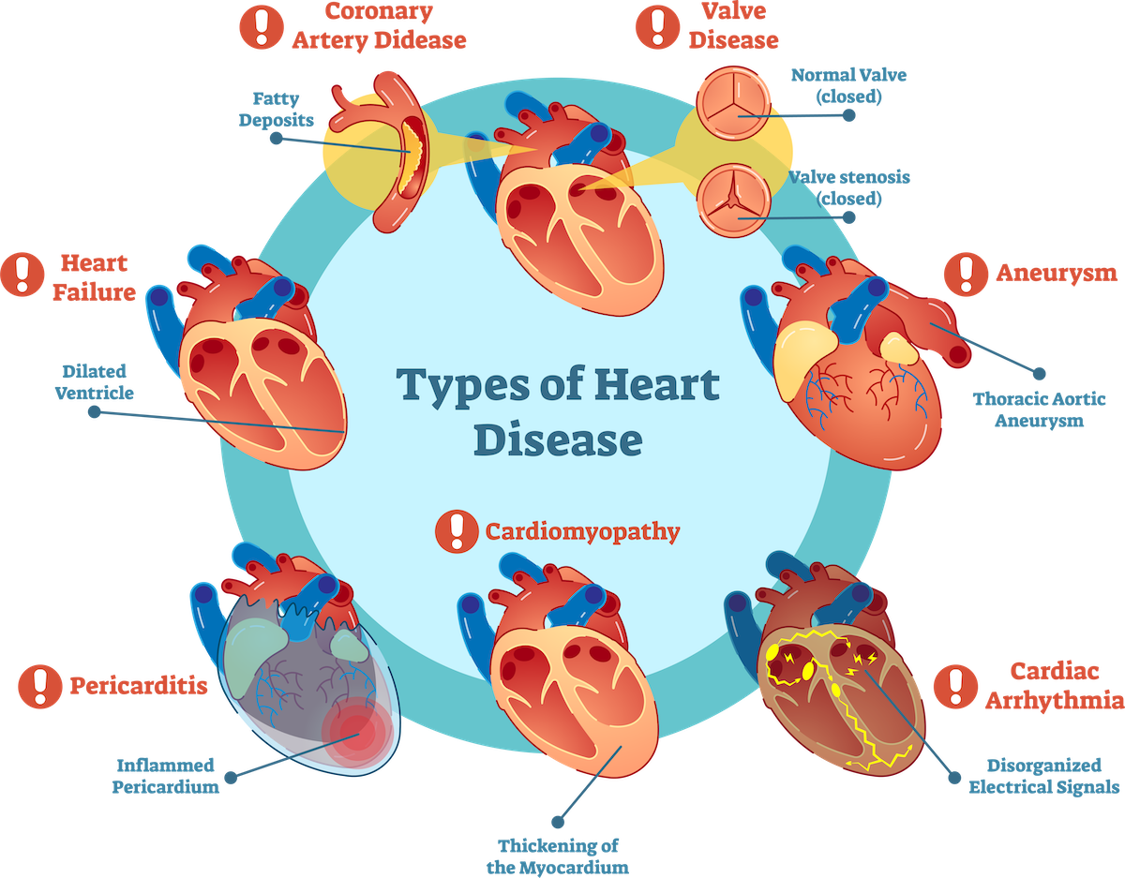
CARDIOVASCULAR DISEASE IS VARIED
BACKGROUND & MOTIVATION
METHODOLOGY
DATA
ANALYSIS
PROPOSED SOLUTIONS
Notes:
Multiple forms of CVD exist, therefore risk factors for CVD is also varied. Most common risk factors include obesity, diabetes, family history, smoking, high cholesterol, and high blood pressure. Other factors, such as low SES, high stress, and other environmental factors must be considered as well. Battling these factors is still an ongoing battle and subject of furious research throughout the United States.

Slide 4
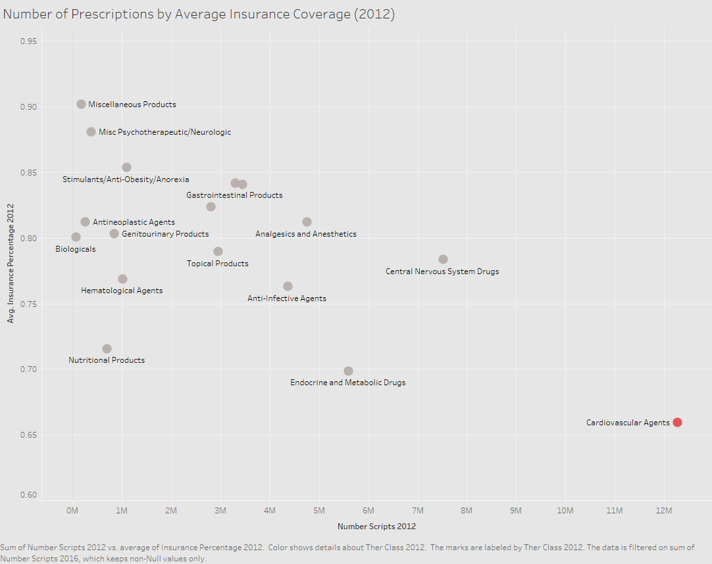
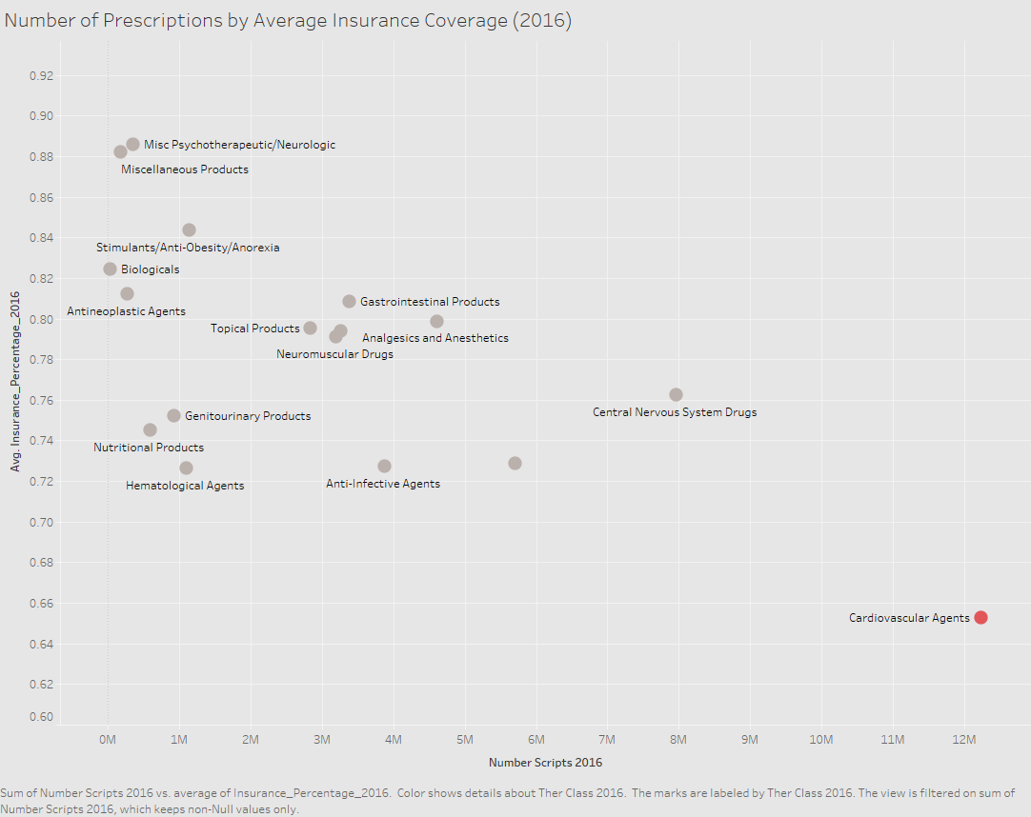
CARDIOVASCULAR AGENTS ARE THE MOST PRESCRIBED
BUT THE LEAST COVERED
BACKGROUND & MOTIVATION
METHODOLOGY
DATA
ANALYSIS
PROPOSED SOLUTIONS
Average Cardiovascular Insurance Coverage (2012): 65.92%
Number of Prescriptions (2012): 12,265,559
Average Cardiovascular Insurance Coverage (2016): 65.26%
Number of Prescriptions (2016): 12,226,831
Notes:
Average Cardiovascular Insurance Coverage (2016): 65.26%
Number of Prescriptions (2016): 12,226,831
Average Cardiovascular Insurance Coverage (2012): 65.92%
Number of Prescriptions (2012): 12,265,559
How can we address this?

Slide 5
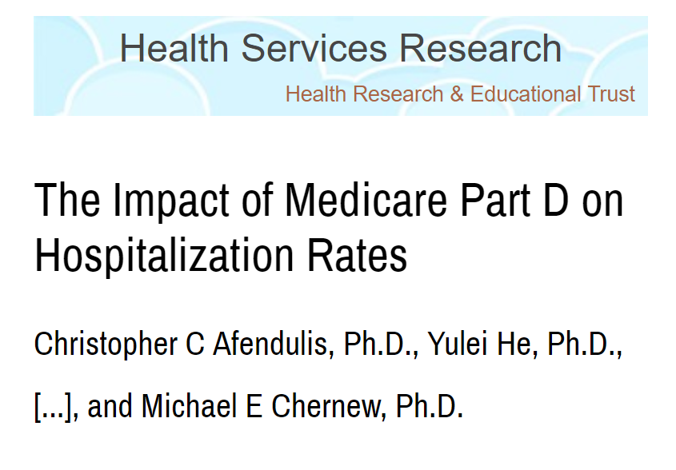
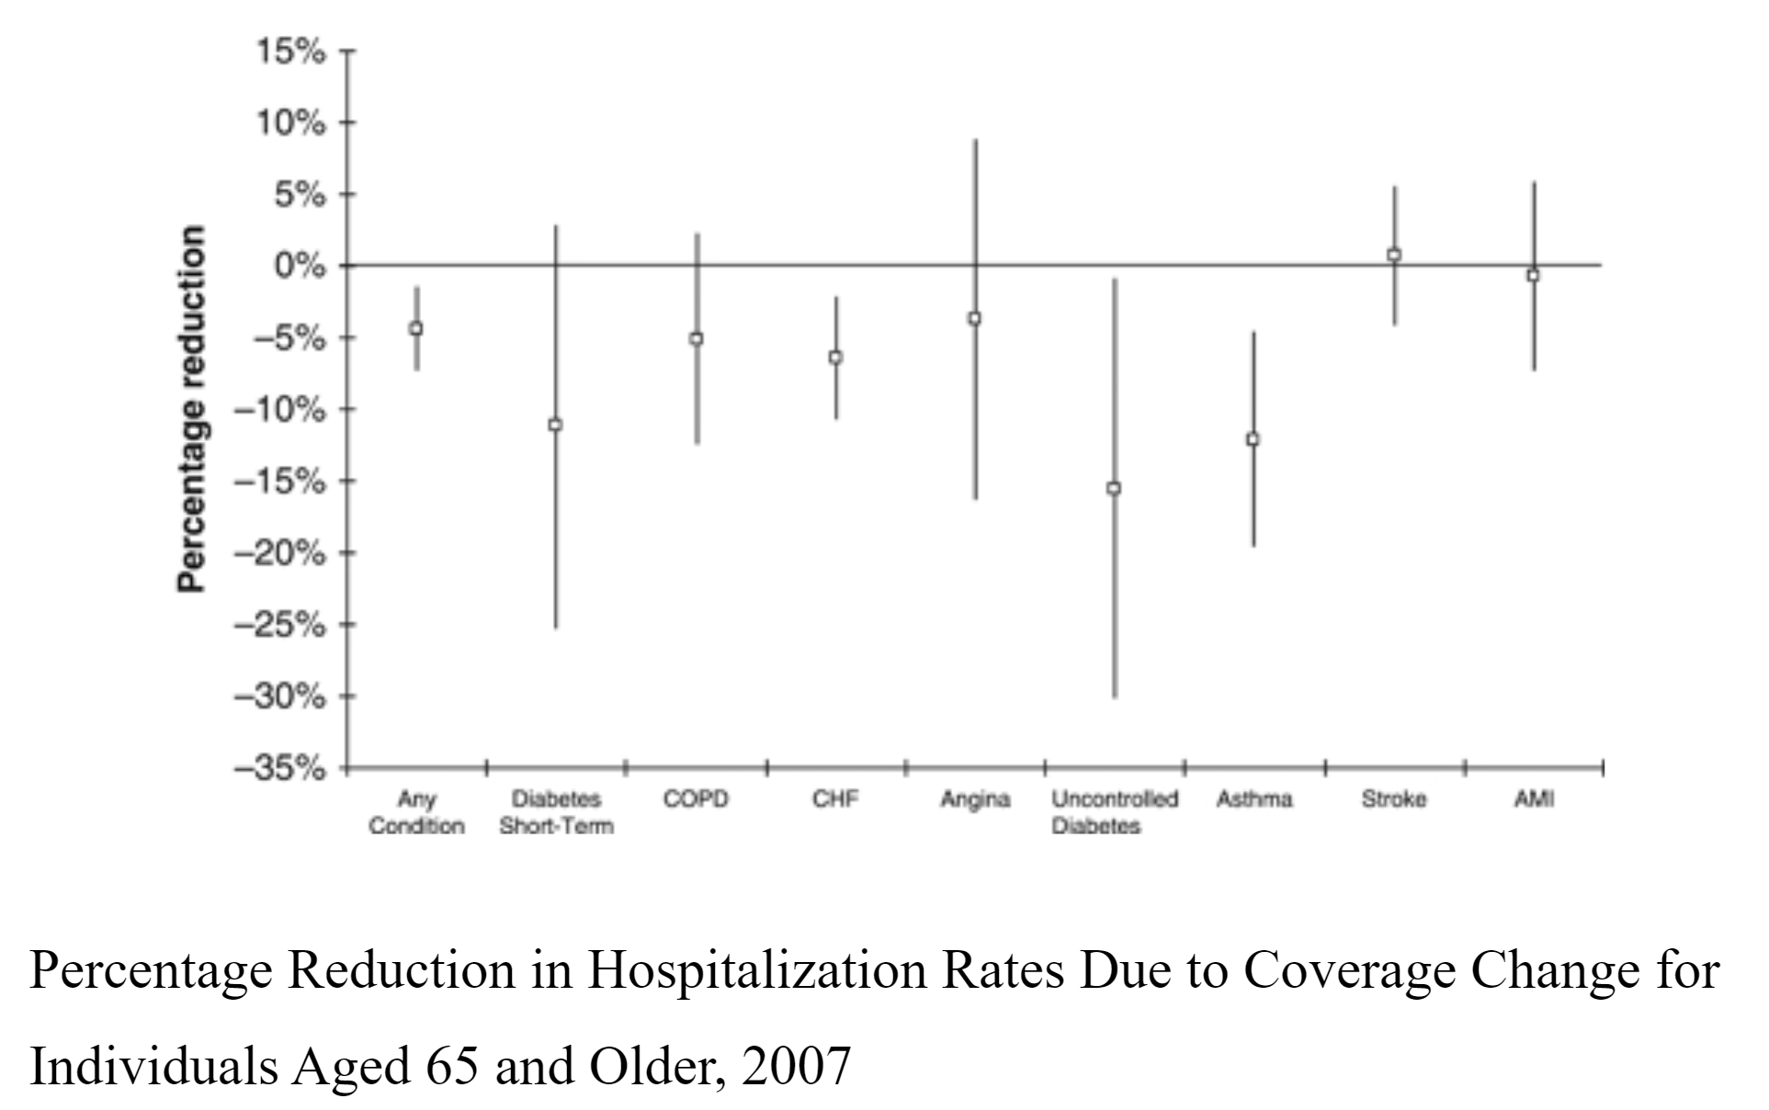
DRUG INSURANCE EXPANSIONS AND PATIENT HEALTH OUTCOMES
BACKGROUND & MOTIVATION
METHODOLOGY
DATA
ANALYSIS
PROPOSED SOLUTIONS
Initiation of Medicare Part D resulted in an increased in drug coverage among the elderly (23-state sample) 61% to 88%.
³
Notes:
Increase coverage to improve patient health outcomes, reduce hospitalizations

Slide 6
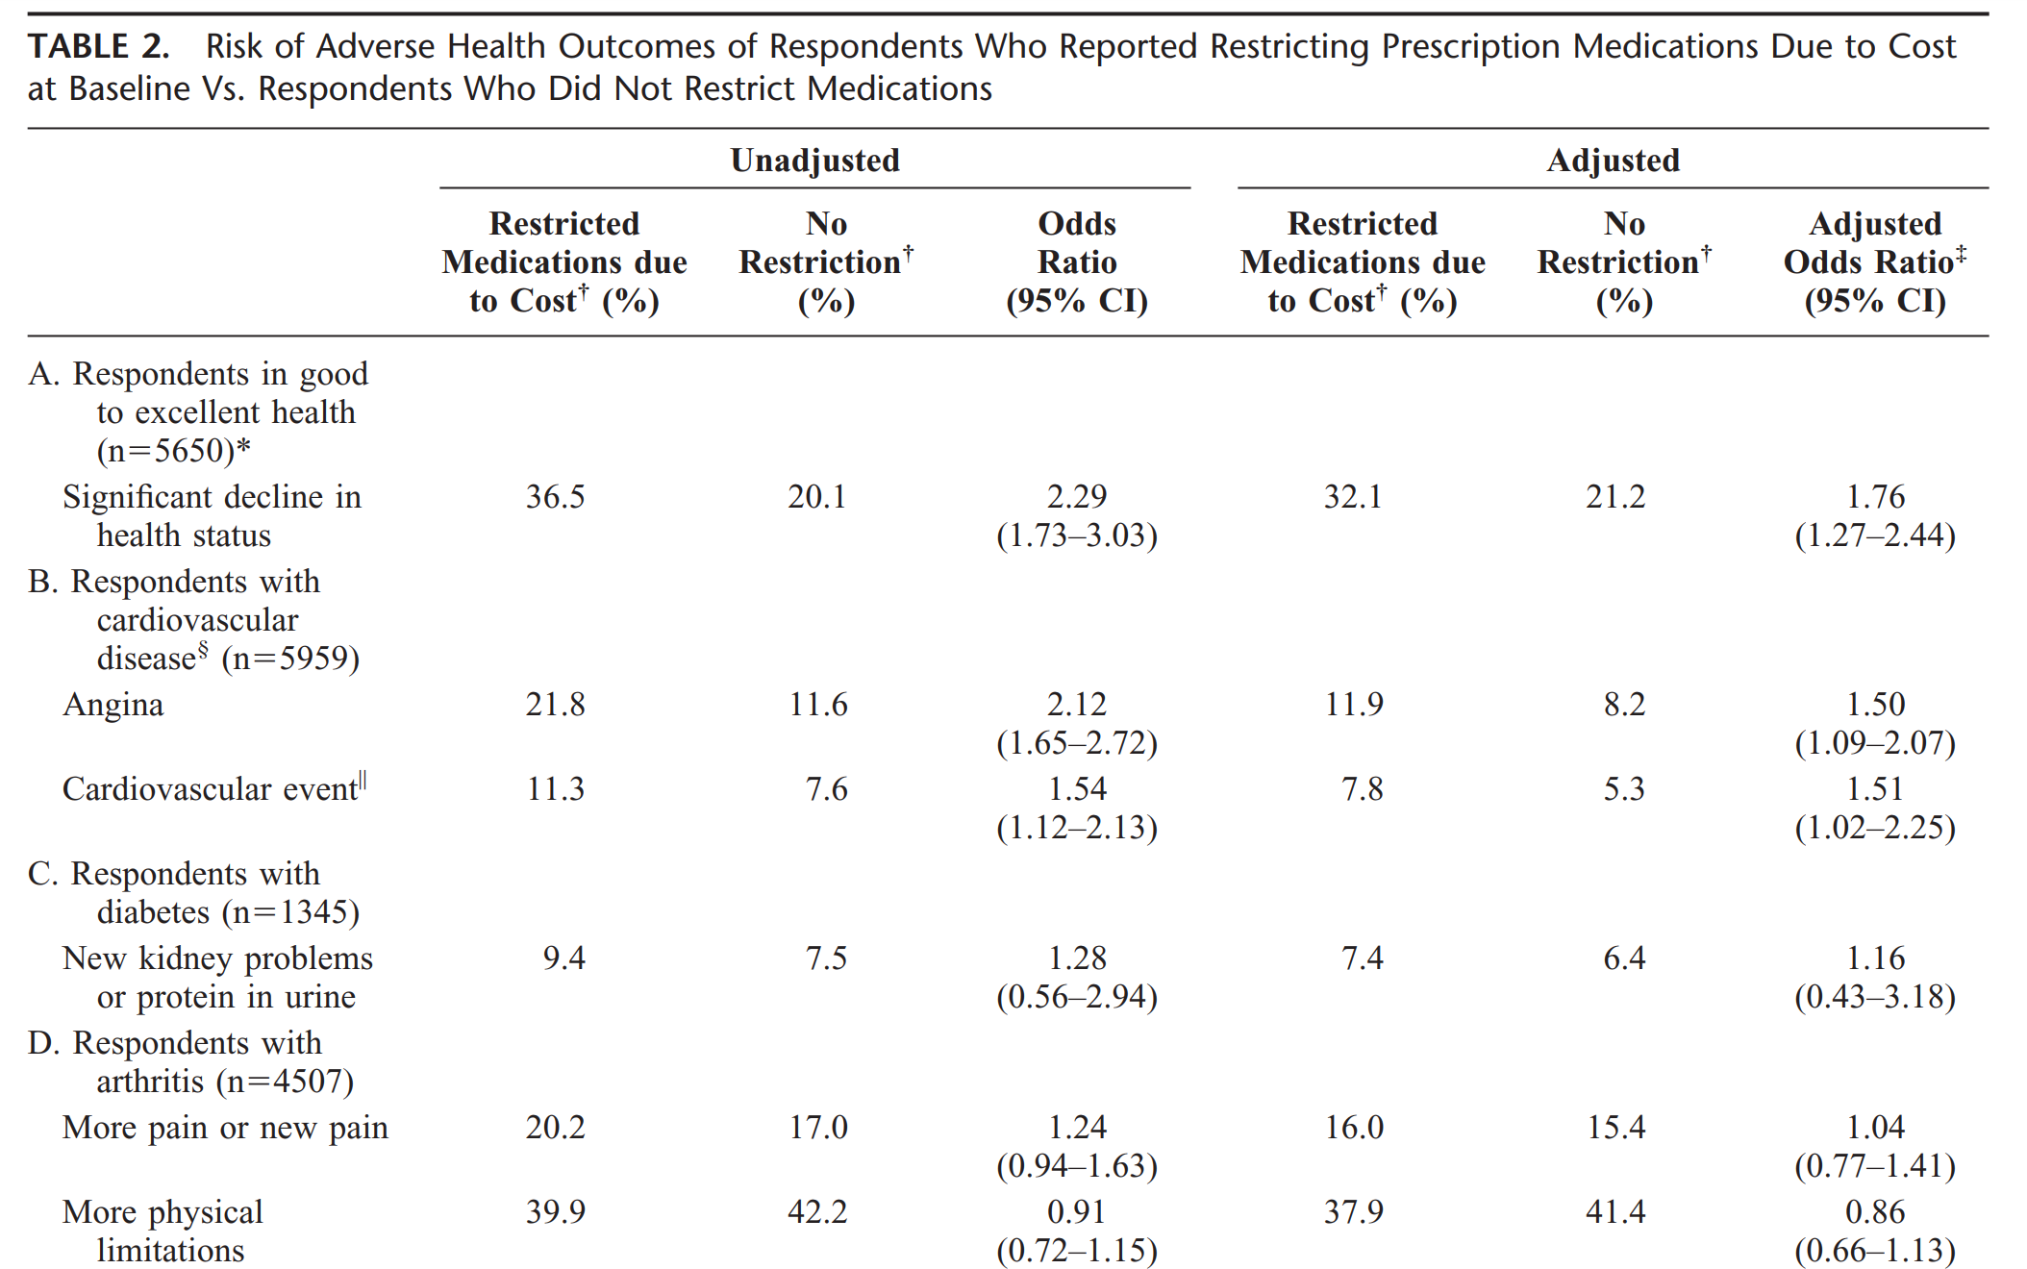
HEALTH EFFECTS OF RESTRICTING PRESCRIPTION MEDICATION COVERAGE
BACKGROUND & MOTIVATION
METHODOLOGY
DATA
ANALYSIS
PROPOSED SOLUTIONS
Heisler et. al (2004)⁴
Notes:
These research slides are good motivation for studying the question

Slide 7

What trends can we uncover that explains the disparity in cardiovascular drug coverage and what can we do to address it?
BACKGROUND & MOTIVATION
METHODOLOGY
DATA
ANALYSIS
PROPOSED SOLUTIONS

Slide 8


DATA SOURCES
BACKGROUND & MOTIVATION
METHODOLOGY
DATA
ANALYSIS
PROPOSED SOLUTIONS
Obtained from Minnesota All Payers Claim Database (years 2012 & 2016)
Contains information regarding a specific drug (launch year, ingredients, dosage)
40 features; 58,299 entries
Drug Details
Drug Summary
Contains information regarding drug characteristics (region distribution, age distribution)
50 features; 8,455 entries

Slide 9



DATA CLEANING
NULLS
JOINS
BUILT
BACKGROUND & MOTIVATION
METHODOLOGY
DATA
ANALYSIS
PROPOSED SOLUTIONS
Impute nulls in ‘PROPNAME’
Drop rows with 10% missing
Join Prescription 2012 and 2016 data on 4 features
Join Drug 2012 and 2016 data on 6 features
Compute percent change between 2012 and 2016 in Prescription
Percentage of insurance coverage in Drug
Notes:
Prescription Join features: ['RECORD_TYPE','NPROPNAME', 'THER_CLASS','PAYER']
Drug Join features: ['NDC9','PRODUCT_NDC', 'RECORD_TYPE','NPROPNAME', 'THER_CLASS’, 'PAYER']
Percent Change computed for columns ‘COST_PER_SCRIPT’ and ‘COST_PER_SCRIPT_RANK’

Slide 10
CLUSTERING ALGORITHM SEPARATED DRUGS BY PAYER
BACKGROUND & MOTIVATION
METHODOLOGY
DATA
ANALYSIS
PROPOSED SOLUTIONS
ATTRIBUTES CONSIDERED
Drug Payer
Gender Distribution
Age Distribution
Area Distribution
Cluster 1
(104 Types)
100 % drugs belong to Commercial
Cluster 2
(106 Types)
100 % drugs belong to Medicare
Cluster 3
(72 Types)
100 % drugs belong to Minnesota Health Care Program

Slide 11
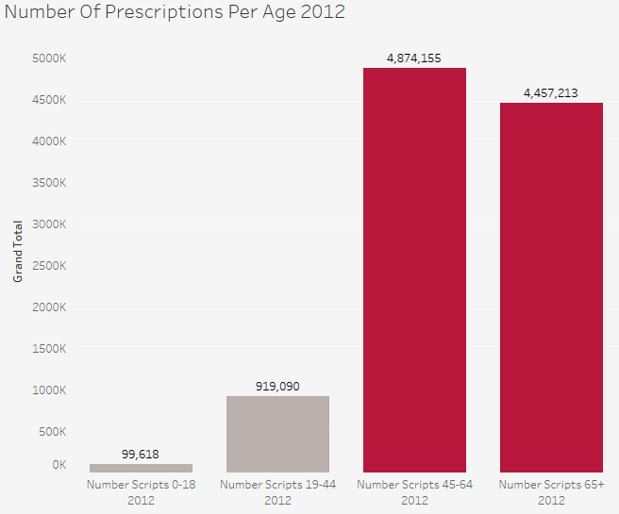
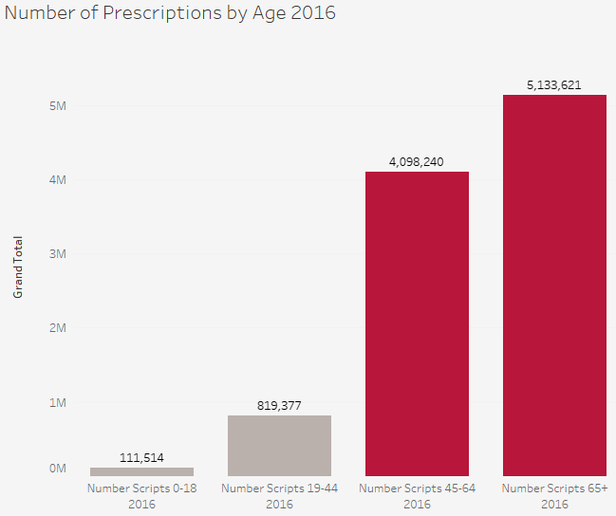
OLDER PATIENTS RECEIVE THE MOST CARDIOVASCULAR AGENT PRESCRIPTIONS
BACKGROUND & MOTIVATION
METHODOLOGY
DATA
ANALYSIS
PROPOSED SOLUTIONS
In 2012, the majority of cardiovascular prescriptions were given to the age group 45-65
In 2016, 65+ makes up the majority of prescriptions
Both groups are significantly higher than the younger patient groups
Notes:
What subset of the population tends to use the cardiovascular drug, and how are they covered? To start, we looked at what age made up the majority of cardiovascular patients.
We found that in 2012, the majority of the patients for cardiovascular drugs do

Slide 12
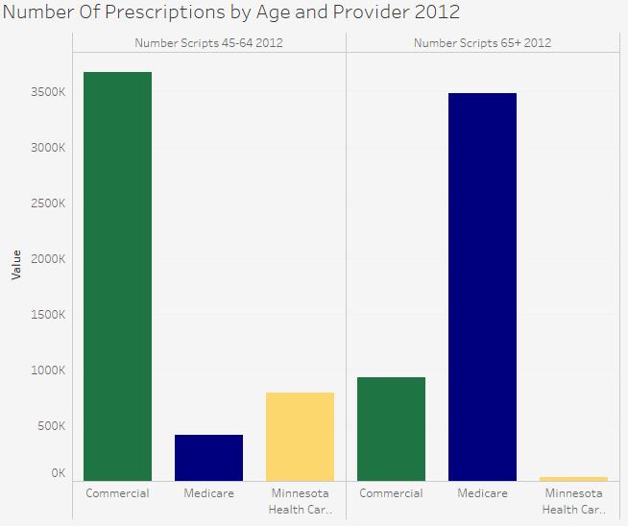
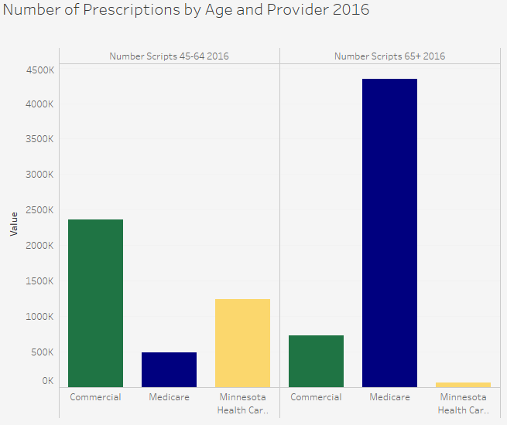
MEDICARE AND COMMERCIAL INSURANCE PROVIDE THE MAJORITY OF COVERAGE FOR THESE AGE GROUPS
BACKGROUND & MOTIVATION
METHODOLOGY
DATA
ANALYSIS
PROPOSED SOLUTIONS
Commercial is the primary payer for Patients Age 45-64
Medicare is the primary payer for Patients Age 65+
Trends are the same for both years
Notes:
The main users of cardiovascular drugs

Slide 13
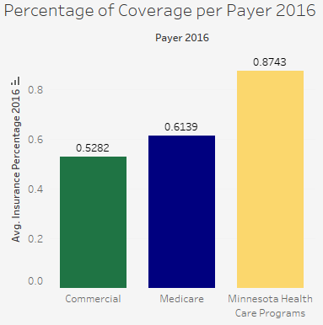
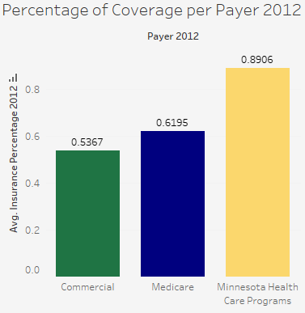
ONLY MINNESOTA HEALTH CARE PROGRAMS OFFER ABOVE AVERAGE COVERAGE
BACKGROUND & MOTIVATION
METHODOLOGY
DATA
ANALYSIS
PROPOSED SOLUTIONS
Average Commercial Coverage: 52.82%
Average Medicare Coverage: 61.39%
Average MCHP Coverage: 87.43%
Trends are not significantly different between years
Notes:
So who’s utilizing the what coverage?

Slide 14
WE RECOMMEND THAT THE STATE OF MN COVERS A PORTION OF OUT OF POCKET COSTS
BACKGROUND & MOTIVATION
METHODOLOGY
DATA
ANALYSIS
PROPOSED SOLUTIONS
Key Findings | Possible Courses of Action
Drug Payers are the Most Distinguishable Attribute Among Patients | Increased state subsidization of Cardiovascular Disease Medication costs
Patients Aged 45 and Older are the Most At Risk for Cardiovascular Issues | Expand Medicare Coverage to the Age 45-64 Age Group
Patients in this age group primarily use Commercial and Medicare Payer | Increase Accessibility and Eligibility for Minnesota Health Care Programs
Commercial and Medicare offer Below Average Coverage | Incentivize Increased Commercial Drug Coverage for patients Age 45+

Slide 15
Cost Benefit Analysis
BACKGROUND & MOTIVATION
METHODOLOGY
DATA
ANALYSIS
PROPOSED SOLUTIONS
Benefits
1. Decreased costs associated with preventable hospitalizations
2. Increased economic activity (i.e increase employment and spending)
3. Lower overall costs for healthcare programs to the state
4. Better overall health for the population
Costs
1. Increased short-term spending by the MN government
2. Increased administrative burden
3. May decrease funding for other programs
Notes:
Source: https://www-nejm-org.ezp1.lib.umn.edu/doi/10.1056/NEJMp1613981
https://www.health.state.mn.us/news/pressrel/2019/costs022819.html
Numbers show

Slide 16
Hypothetical Cost Benefit Analysis for MN
BACKGROUND & MOTIVATION
METHODOLOGY
DATA
ANALYSIS
PROPOSED SOLUTIONS
Over the course of 1 year...
Assume a 5% reduction in hospitalizations due to CVD³
The average cost of a CVD hospitalization is $16000⁵
There were 45000 hospitalizations due to CVD⁶
Benefits
45,000
45,000 x $16,000 x 5%
$36 Mil
45,000 x $16,000
Costs
$21.8 Mil
$109 Mil x 20%
State government covers 20% of out-of-pocket cost for cardiovascular medications
$109 Mil
Individuals pay on average $109 Mil for cardiovascular medications
$14.2 Mil Net Savings
Notes:
Source: https://www-nejm-org.ezp1.lib.umn.edu/doi/10.1056/NEJMp1613981
https://www.health.state.mn.us/news/pressrel/2019/costs022819.html (Source for total heart healthcare spending in MN in 2013)
https://www.health.state.mn.us/diseases/cardiovascular/data/heartdisease.html (Source for CVD hospitalizations in MN)
https://www.ncbi.nlm.nih.gov/pmc/articles/PMC5436769/ (Source showing cost of CVD hospitalization in USA)
Numbers show

Slide 17



CAVEATS
COST BURDEN
ADHERENCE
LIMITED DATA
BACKGROUND & MOTIVATION
METHODOLOGY
DATA
ANALYSIS
PROPOSED SOLUTIONS
Knowing cost burden could help determine whether or not possible lack of medication adherence is related to cost
With the given data, we cannot be certain if lack of medication adherence is a primary risk for CVD
With only data for two years (2012 and 2016), any causal assumptions are limited in scope

Slide 18
PREVENTION MATTERS
BACKGROUND & MOTIVATION
METHODOLOGY
DATA
ANALYSIS
PROPOSED SOLUTIONS
Healthy Routines
Medical Access
Healthy Diet
Improved
Heart Health
Notes:
Source 4: https://www.cdc.gov/heartdisease/prevention.htm
Source 5: https://www.ncbi.nlm.nih.gov/pmc/articles/PMC4318289/
Source 6: https://www.ncbi.nlm.nih.gov/pmc/articles/PMC4602927/
Despite the many risk factors of CVD, evidence shows can be prevented through regular check ups/health maintenance, regular exercise, and a healthy diet. Especially important for medicinal and regular preventative medical care is insurance. Which has been shown to better outcomes for CVD.

Slide 19
CONCLUSION
PROBLEM
INSIGHTS
SOLUTION
BACKGROUND & MOTIVATION
METHODOLOGY
DATA
ANALYSIS
PROPOSED SOLUTIONS
There is a disparity between Cardiovascular Drug Usage and Insurance Coverage
The disparity is most apparent for patients 45+ with either commercial or Medicare coverage
Addressing the disparity by increasing CVD prescription coverage for this at risk population may increase health outcomes and reduce costs

Slide 20
THANKS!
Interdisciplinary Health Data Competition
B. Byun, P. Cho, L. Moore, B. Wei, & W. Wu

Slide 21
REFERENCES
[1]Tejada-Vera B. Leading Causes of Death: United States, 1999–2017. National Center for Health Statistics. 2019. Designed by B Tejada-Vera, L Lu, E Arias, JM Keralis, and Y Chong: National Center for Health Statistics.
[2]National Center for Health Statistics. Vital statistics data available. Mortality multiple cause files. Hyattsville, MD: National Center for Health Statistics.
[3]Afendulis, C. C., He, Y., Zaslavsky, A. M., & Chernew, M. E. (2011). The Impact of Medicare Part D on Hospitalization Rates. Health Services Research, 46(4), 1022–1038. doi: 10.1111/j.1475-6773.2011.01244.x
[4]Heisler, M., Langa, K. M., Eby, E. L., Fendrick, A. M., Kabeto, M. U., & Piette, J. D. (2004). The Health Effects of Restricting Prescription Medication Use Because of Cost. Medical Care, 42(7), 626–634. doi: 10.1097/01.mlr.0000129352.36733.cc
[5]Kilgore, M., Patel, H., Kielhorn, A., Maya, J., & Sharma, P. (2017). Economic burden of hospitalizations of Medicare beneficiaries with heart failure. Risk Management and Healthcare Policy, Volume 10, 63–70. doi: 10.2147/rmhp.s130341
[6]MN Hospital Uniform Billing (UB) Claims Data, Health Economics Program, MDH and Minnesota Hospital Association.

